Slide 1
REAL-WORLD API MODULARIZATION WITH DDD AND HYPERMEDIA
@EINARWH
Notes:
Hi, welcome to this talk on real-world API modularization with DDD and hypermedia.

Slide 2

Notes:
I work for NRK TV. NRK is the public broadcaster i Norway, NRK TV is our TV streaming service.

Slide 3
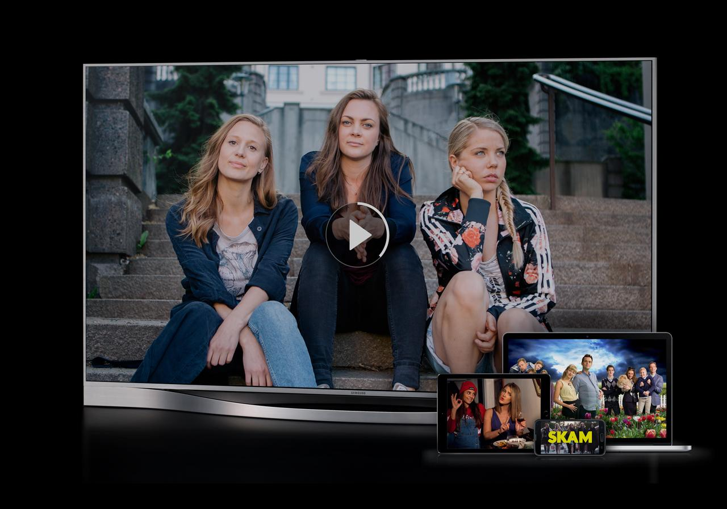
Notes:
So if you’re a Norwegian, you can use our service, NRK TV, to watch TV programming for a Norwegian audience, using your browser, your mobile phone or your smart TV. It is a serious software system in the sense that we have something like half a million users watching roughly half a million hours of content every day. I’m telling you that as sort of a backdrop or context for the talk. It has an impact in terms of how we approach evolving our architecture.

Slide 5
AGENDA

Slide 6
ARCHITECTURE CHALLENGES AT NRK TV
Notes:
First I’d like to talk a little bit about the particular architecture challenges we face at NRK TV. Some of them might be similar to some of your architecture challenges, some might be a little bit different. Architecture is always contextual.

Slide 7
APPLICATION OF DOMAIN-DRIVEN DESIGN
Notes:
Then I’m going to talk a little about how we take some ideas from domain-driven design to try to tackle some of those architecture challenges.

Slide 8
INTRODUCTION TO HYPERMEDIA
Notes:
Then I’d like to do a short introduction to hypermedia.

Slide 9
HYPERMEDIA IN PRACTICE AT NRK TV
Notes:
And then I’d like to show some work we’ve done at NRK TV that involves hypermedia.

Slide 10
HYPERMEDIA IS ABOUT ARCHITECTURE
Notes:
And I hope by the end of this talk I’ll have convinced you that hypermedia really is about architecture.

Slide 12
ARCHITECTURE CONCERNS AT NRK TV
Notes:
So about those architecture concerns at NRK TV.

Slide 13
SOCIO-TECHNICAL CONTEXT
Notes:
I’d like to start with a little bit of socio-technical context.

Slide 14
BUSINESS PERSPECTIVE
Notes:
In fact, I’d like to take sort of a business perspective on the situation we face at NRK TV.

Slide 15
RAPIDLY EVOLVING DOMAIN
Notes:
We’re working in a rapidly evolving domain. TV streaming is a pretty competitive business.

Slide 16
MUST STAY COMPETITIVE
Notes:
That means that we must stay competitive. We have some pretty significant competitors. It used to be back in the good old days that we competed with other Norwegian broadcasters. Now we compete with Netflix, YouTube, HBO, Disney+ and so forth. We can’t beat them on resources, so we must be smart about what we do.

Slide 17
MUST BE NIMBLE
Notes:
And to be competitive, we must stay nimble. We must be able to change as the domain evolves.

Slide 18
ORGANIZATION
Notes:
In terms of organization.

Slide 19
MULTIPLE TEAMS AT NRK TV
Notes:
We are organized as multiple teams at NRK TV.

Slide 20
COLLABORATION WITH NRK RADIO AND NRK SUPER
Notes:
We also collaborate closely with NRK Radio and NRK Super which is targeted at children.

Slide 21
INTERACTIONS WITH OTHER PARTS OF THE ORGANIZATION
Notes:
And of course we have interactions with lots of other parts of the organization as well, production, planning, legal department and so forth, but I’m going to gloss over that, because already the picture is becoming too complicated for a talk like this. So I’m going to pretend that NRK TV lives in a vacuum even though it doesn’t.

Slide 22
A SYSTEM IN A SYSTEM OF SYSTEMS
Notes:
We are a system in a system of systems, but we’re going to simplify a bit and focus only on NRK TV, that’s already complicated enough.

Slide 23
WE MUST SUPPORT AUTONOMY
Notes:
We must support some degree of autonomy for these various teams working at NRK TV.

Slide 24
WE MUST SUPPORT EXPERIMENTS
Notes:
We must enable those teams to carry out experiments, try out new things, without having to coordinate with everyone else.

Slide 25
WE MUST SUPPORT CHANGE
Notes:
We must support change and at the same time

Slide 26
WE MUST PROVIDE STABILITY
Notes:
We must provide stability.

Slide 27
WE MUST IMPROVE STABILITY
Notes:
In fact it gets worse, not only must we provide stability, we must improve that stability every year. Because as TV streaming gets more popular, it takes on more of the responsbility of the traditional linear broadcast for having a high uptime. As a public broadcaster, in the case of a national crisis, for instance a pandemic, we must be up to tell the public what has happened. That’s part of our mission as a public broadcaster.

Slide 28
TECHNICAL PERSPECTIVE
Notes:
From a technical perspective

Slide 29
THE NRK TV PLAYER API
Notes:
I’m going to talk about the Player API which is what I’m working on. It serves metadata and media manifests for TV shows to all those different clients that people use to watch TV online.

Slide 30
MANY CLIENTS
Notes:
There are a bunch of different clients. You have your laptops, your tablets, your phones, your smart-TVs. Very roughly you can group them into two groups.

Slide 31
PROGRESSIVE CLIENTS
Notes:
On the one hand you have progressive clients, like our browser client, that might deploy every day and try out new features. This also includes our apps for iOS and Android.

Slide 32
LEGACY CLIENTS
Notes:
On the other hand you have legacy clients, such as clients running on an old smart TV. It doesn’t necessarily get updated that often. So we’re looking at radically different deployment cycles.

Slide 33
IMPACT ON ARCHITECTURE
Notes:
Of course that has an impact on architecture, we need to accommodate both those scenarios.

Slide 35
CA 2016
Notes:
So I’d like to take you five years back in time.

Slide 36
MONOLITHIC WEB API SERVING MANY CLIENTS
Notes:
At that point in time, we had a monolithic web api serving all those different clients.

Slide 37
RUNS IN AZURE TWO DATA CENTERS
Notes:
It was running in Azure in two data centers for redundancy.

Slide 38
BACKED BY RELATIONAL DATABASE
Notes:
It was backed by a relational database.

Slide 39
VARIOUS SUPPORTING WORKER JOBS
Notes:
And it had some supporting worker jobs that would preprocess some data and stuff like that.

Slide 40
CUNNING CACHING SCHEMES
Notes:
And it employed some more or less cunning caching schemes to try to make things go around. And that was working, in the sense that software works.

Slide 41
OVERWHELMING COMPLEXITY
Notes:
But the complexity was kind of overwhelming. And you can imagine, coming as a new developer and trying to wrap your head around all that and implement new things without breaking old things, that could be a pretty tough challenge.

Slide 42
LARGELY UNREASONABLE
Notes:
It was largely unreasonable, both literally and metaphorically.

Slide 43
COMPLEX FAILURE MODES
Notes:
There were complex failure modes.

Slide 44
UNFORESEEN EFFECTS OF CHANGE
Notes:
And the effects of change were hard to predict.

Slide 45
BUGS
Notes:
And as a consequence we introduced bugs.

Slide 46
FEAR OF CHANGE
Notes:
And when you introduce bugs too often you get scared. You’d rather not change anything.

Slide 47
STAGNATION
Notes:
And that leads to stagnation which is not what you want.

Slide 48
RELIANCE ON RELEASE MANAGER GENIUS
Notes:
So to navigate and coordinate all that, we relied on a person who was like a release manager genius. One who had a sixth sense for hidden dependencies and sort of knew what we needed to check to deploy relatively safely. So he was very good at that, but at the same time, that’s not a good situation to be in.

Slide 49
WHAT TO DO?
Notes:
So what should we do?

Slide 50
REWRITE?
Notes:
Should we rewrite our API?

Slide 51
WHAT DO YOU MEAN REWRITE?
Notes:
What do you mean rewrite, I just said that we have half a million users every day.

Slide 52
WE CAN’T REWRITE!
Notes:
We can’t rewrite! And of course the competition is not going to stop development for three years while we rewrite everything.

Slide 53
SO HOW DO WE REWRITE?
Notes:
So we can’t rewrite – so how do we rewrite?

Slide 54
WE MUST EVOLVE!
Notes:
We have to evolve into whatever we wanted to rewrite to. We must rewrite as we og.

Slide 56
WHERE DID THE MONOLITH COME FROM?
Notes:
But before we can even start to do that, I think we need to take a step back and consider where did this complex monolith come from in the first place? Why did we end up in this situation that we’re in?

Slide 57
THE ENTITY
Notes:
And I’m going to blame the entity for that.

Slide 58
THE ENTITY IS THE MONOLITH
Notes:
I think that the entity really is the monolith.

Slide 59
THE ENTITY SNOWBALLS COMPLEXITY
Notes:
The entity is the thing that snowballs complexity.

Slide 60
THE ENTITY IS THE BIG BALL OF MUD
Notes:
Or maybe I should say mudballs, because the entity is the big ball of mud.

Slide 61
FOR NRK TV THE TV SHOW IS THE ENTITY
Notes:
The entity is an abstract thing. For NRK TV, the TV show is that entity. And in case your not convinced, let me try to show you what I mean by that.

Slide 62
ACCESSIBILITY
CDN
MEDIA MANIFEST
BINGE WATCHING
RATING
IMAGES
USAGE RIGHTS
SERIES
EPISODES
FAVORITES
PROMOTIONS
TV
SHOW
TV
SHOW
ON DEMAND
IP CHECK
REPORTING
HIT TITLES
SEARCH
AGE CONTROL
SUBTITLES
CATEGORY
RECOMMENDATIONS
HISTORY
CONTRIBUTORS
POPULARITY
LIVE
Notes:
So here is a different attempt to show essentially the same thing. As you can see, a TV show has a lot of aspects to it. And these are all important things to us. These are the ingredients that make up our service.

Slide 63
WHAT IS A TV SHOW?
Notes:
So when you ask a question like what is a TV show?

Slide 64
WHO’S ASKING?
Notes:
So it really depends, who is asking?

Slide 65
FUNCTIONAL DECOMPOSITION
Notes:
And this offers us an angle at tackling this complexity, and opportunity to do functional decomposition.

Slide 66
BOUNDED CONTEXTS
Notes:
So we can think of TV shows in various contexts. And this is where domain-driven design enters the picture. If we can try to define some useful bounded contexts, maybe we don’t have to think of all those different things at once all the time.

Slide 67
TV SHOW IN THE CATALOG CONTEXT
Notes:
So it might be simpler to consider a TV show in the context of an on demand catalog that you can browse to figure out what you want to watch.

Slide 68
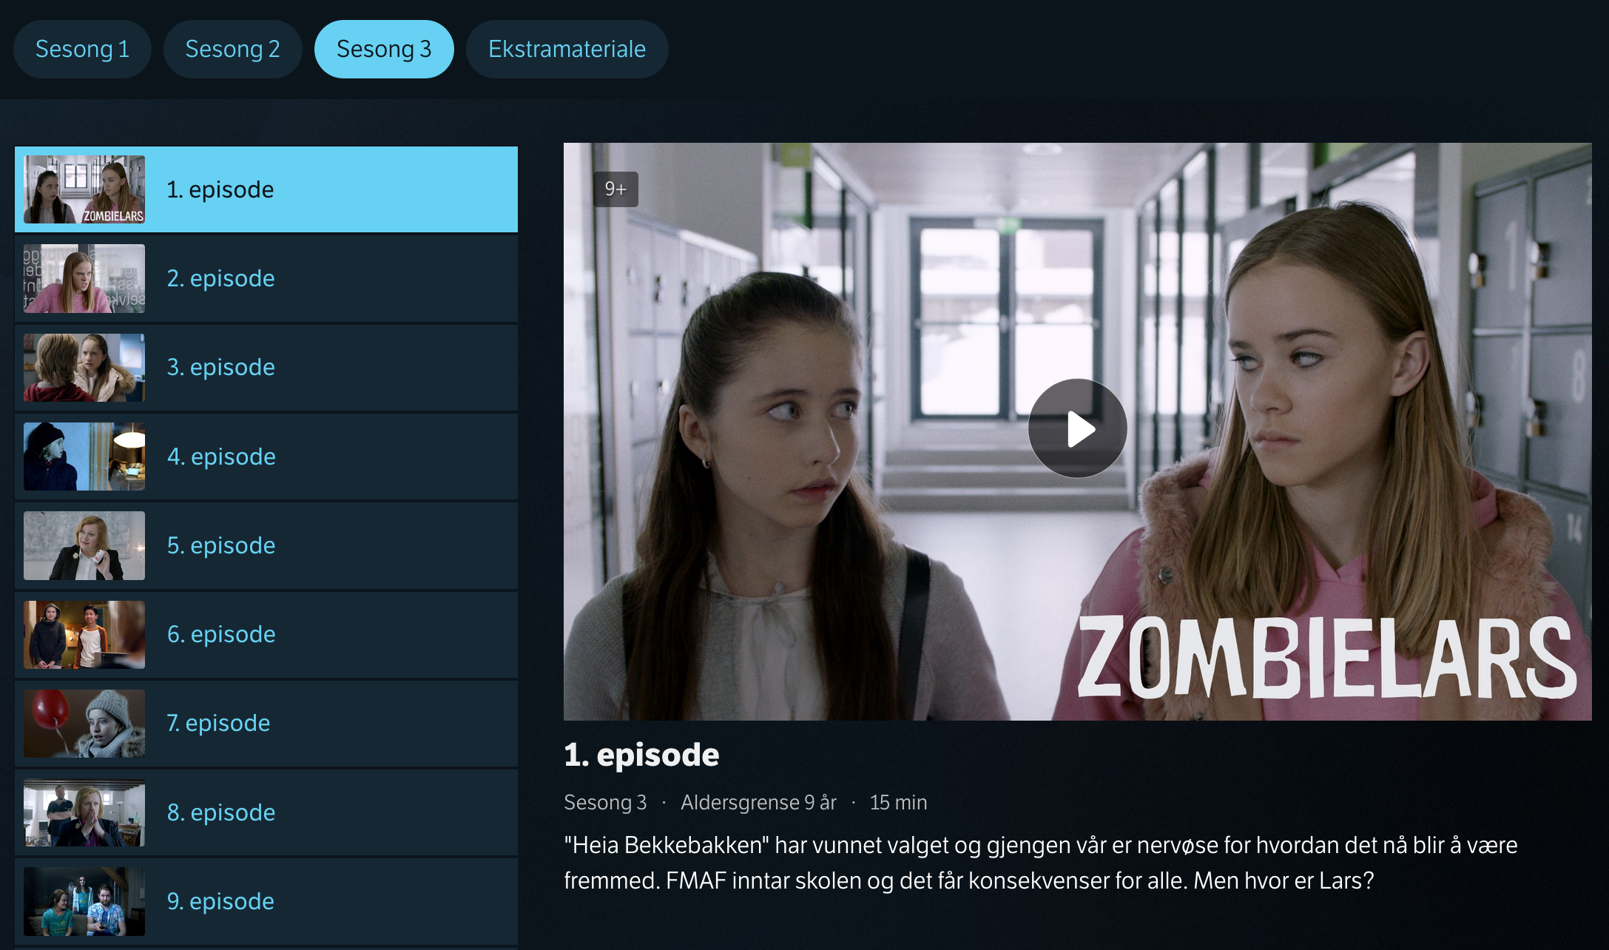
Notes:
So here is a TV show in the catalog context, this is the TV show Zombielars, which is about a kid who is just like all the other kids except he’s a zombie and that makes people treat him differently. So you can see various metadata about this TV show, we have three seasons of this show, some extra material, apparently there are 9 episodes in season three, each episode has a description, an age limit, a duration, a poster image and so forth. But it’s all metadata, it’s not the actual media stream itself.

Slide 69
COMPLEXITY WITH RESPECT TO
Notes:
So there you have complexity with respect to

Slide 70
METADATA DESCRIBING THE MEDIA CONTENT
Notes:
Metadata that describes the media content.

Slide 71
WHAT KINDS OF TV SHOWS ARE THERE?
Notes:
An interesting question in the catalog context might be, what kinds of TV shows are there?

Slide 72
HOW SHOULD THEY BE PRESENTED?
Notes:
How should they be presented?

Slide 73
WHAT’S THEIR LOGIC?
Notes:
Whats their logic?

Slide 74
A TV SERIES WITH EPISODES IS DIFFERENT FROM THE DAILY NEWS IS DIFFERENT FROM A SPORTS EVENT IS DIFFERENT FROM A TALK SHOW IS DIFFERENT FROM A DOCUMENTARY IS DIFFERENT FROM …
Notes:
We have a lot of different kinds of TV shows or TV series.

Slide 75
DIFFERENT CONTENT IS CONSUMED DIFFERENTLY
Notes:
And this is important when we present content to the end user, because different content is consumed differently. You might want to binge watch Zombielars, you’re not going to binge watch the daily news. Instead you’re just going to watch the latest instalment.

Slide 76
TV SHOW IN THE PLAYBACK CONTEXT
Notes:
In the playback context, things look different.

Slide 77
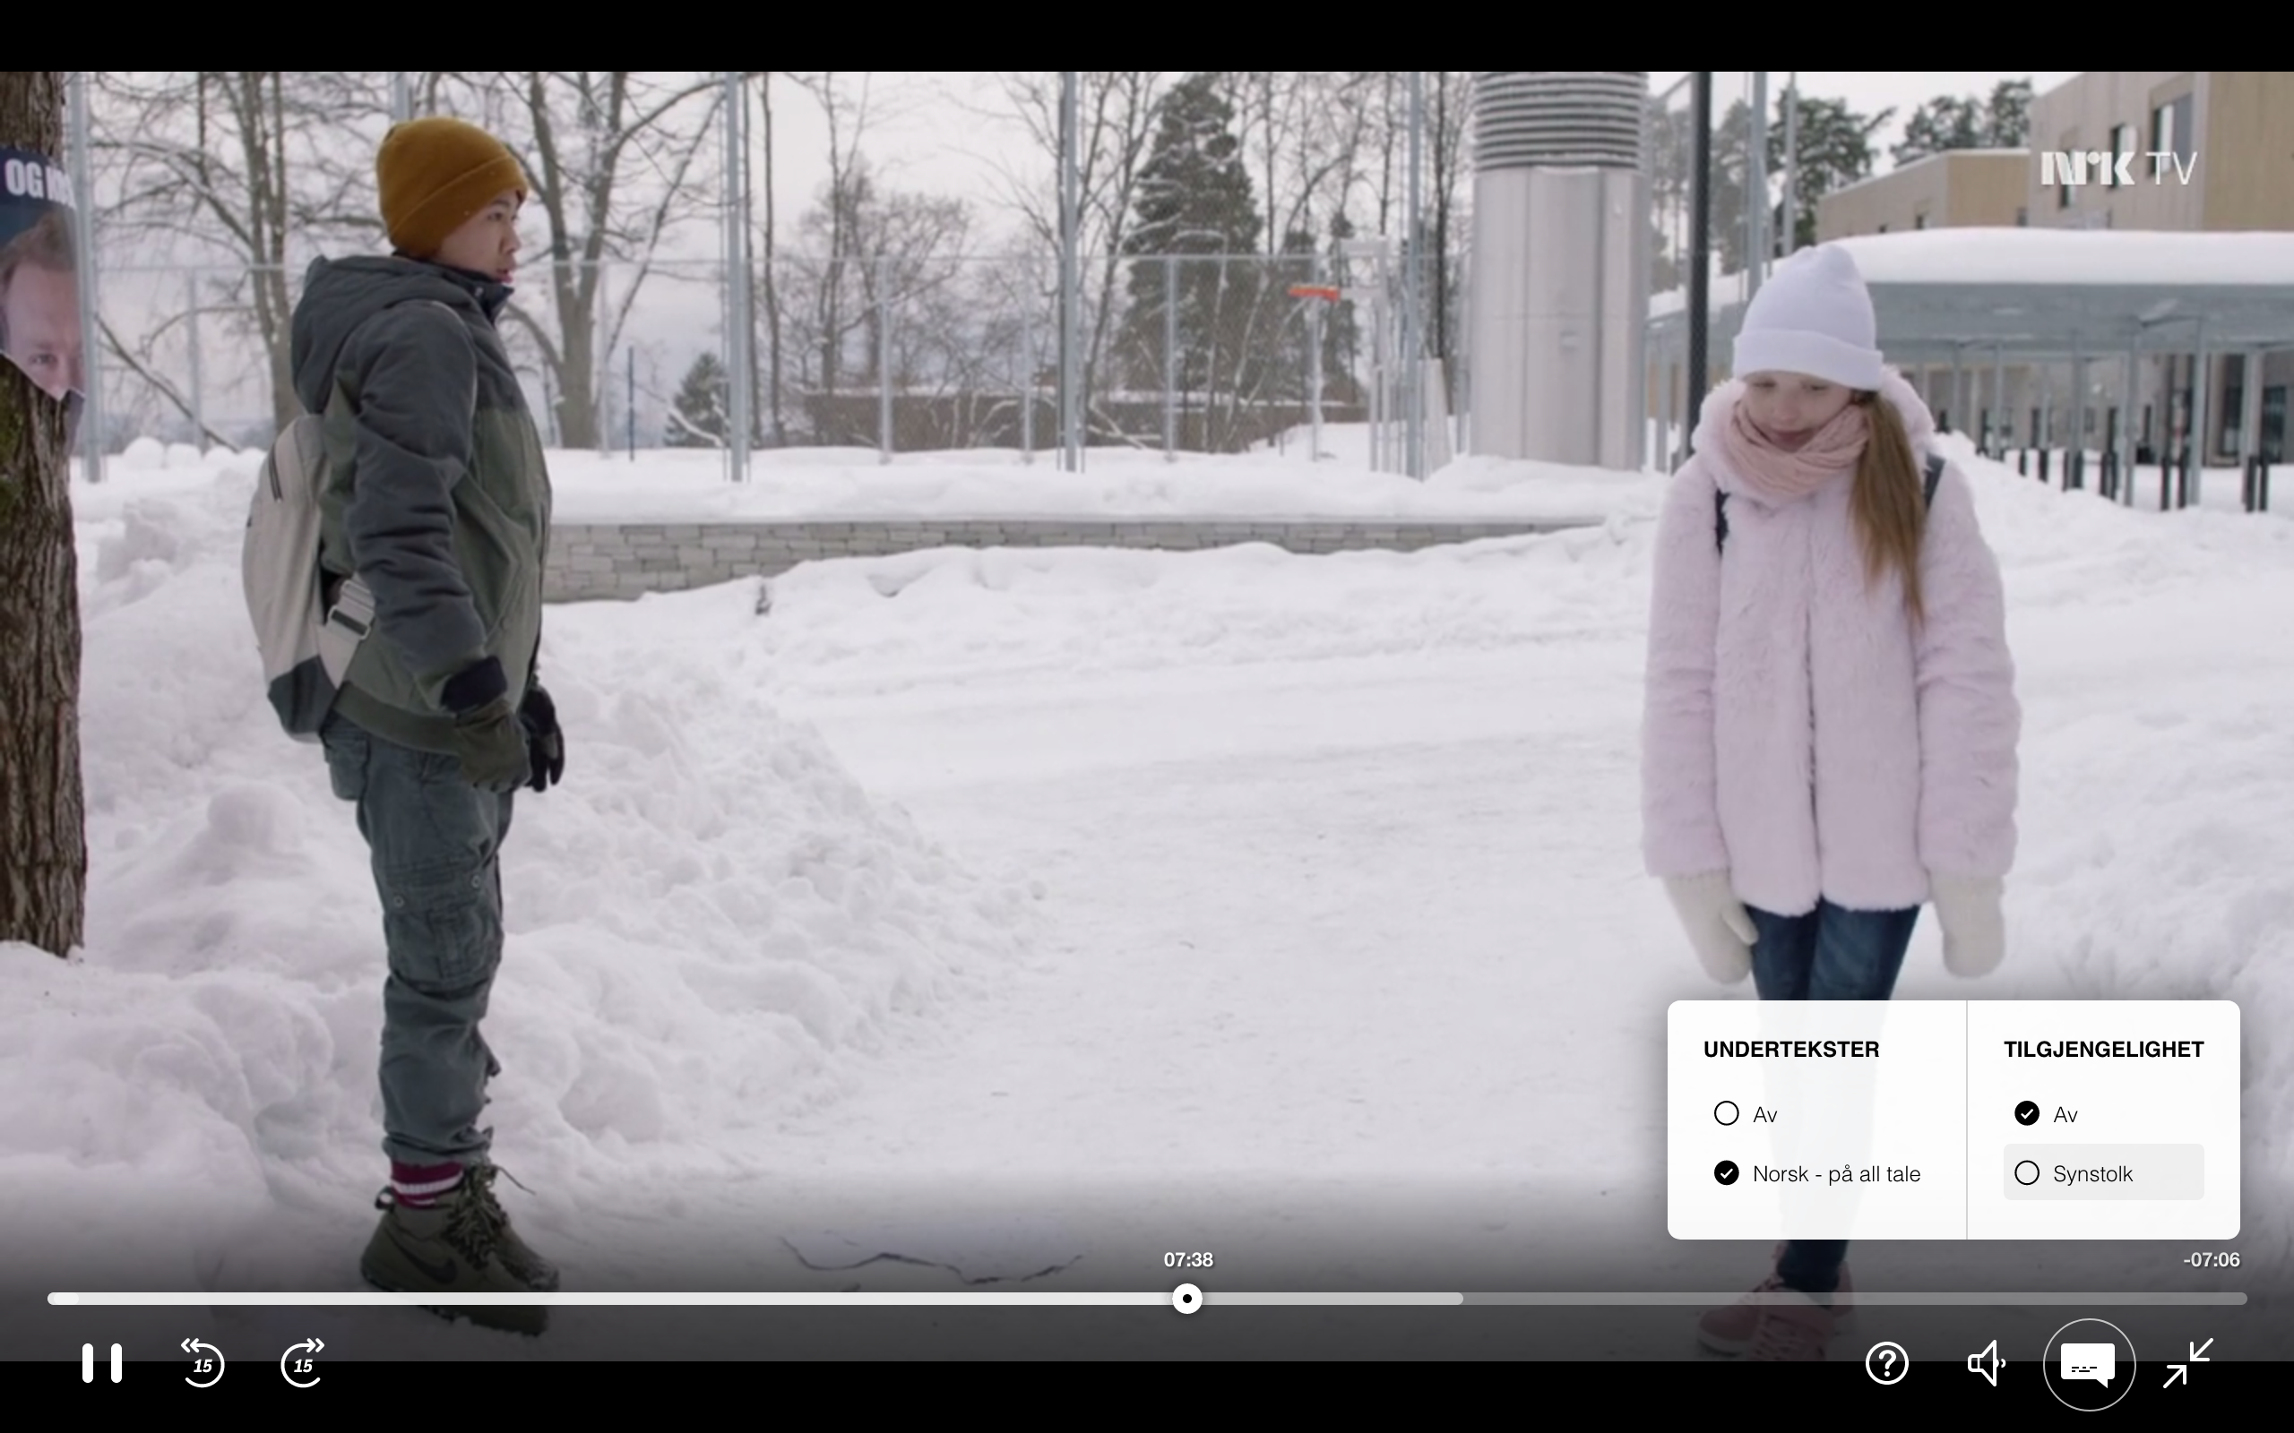
Notes:
This is Zombielars again, but in the playback context. This is related to the actual stream. Here you see how far you’ve watched, there are accessibility versions, you can turn subtitles on and off and so forth.

Slide 78
COMPLEXITY WITH RESPECT TO
Notes:
And in this context you have a lot of complexity, some of it obvious, some of it more hidden.

Slide 79
PLAYING THE ACTUAL MEDIA CONTENT
Notes:
It’s related to playing the actual media content.

Slide 80
SUPPORT FOR VARIOUS KINDS OF MEDIA MANIFESTS
Notes:
So for instance there is complexity related to supporting various kinds of media manifests for different devices.

Slide 81
STREAMING QUALITY
Notes:
You’re interested in streaming quality.

Slide 82
ADAPTING BIT RATE TO DEVICE AND NETWORK
Notes:
Adaptive bit rates.

Slide 83
SUPPORTING ACCESSIBILITY VERSIONS
Notes:
And again accessibility versions are important, since we’re a service for everyone.

Slide 84
WHAT ABOUT OTHER CONTEXTS?
Notes:
Those are two contexts, what about others?

Slide 85
CATALOG
DESKING
SEARCH
TV
SHOW
RECOMMEND
ATIONS
PERSONAL IZATION
PLAYBACK
Notes:
So here’s a crude simplification of our attempt to break our system into different contexts, different lenses if you will, for viewing a TV show and organizing our API.

Slide 86
CONTAINMENT OF COMPLEXITY
Notes:
The main reason for doing this is to try to contain complexity.

Slide 87
DIFFERENT GOALS AND REQUIREMENTS
Notes:
But it’s also about trying to identify and exploit different goals and requirements. And what do I mean by that?

Slide 88
CATALOG
DESKING
SEARCH
TV
SHOW
RECOMMEND
ATIONS
PERSONAL IZATION
PLAYBACK
Notes:
So if we look at this.

Slide 89
CATALOG
DESKING
SEARCH
CRITICALITY?
TV
SHOW
RECOMMEND
ATIONS
PERSONAL IZATION
PLAYBACK
Notes:
If we think of something like criticality. What’s the most critical part of this service?

Slide 90
CATALOG
DESKING
SEARCH
TV
SHOW
RECOMMEND
ATIONS
PERSONAL IZATION
PLAYBACK
Notes:
If you come to our service and you can’t watch TV, nothing else really matters. You’re not going to be happy just browsing our catalog if you can’t watch anything. So that’s really the most critical thing.

Slide 91
CATALOG
DESKING
SEARCH
TV
SHOW
RECOMMEND
ATIONS
PERSONAL IZATION
PLAYBACK
Notes:
And then you have the parts of the service that help you find what you want to watch. That’s kind of important too. Whereas personalized recommandations, you can get through the evening just fine without that.

Slide 92
CATALOG
DESKING
SEARCH
TV
SHOW
RECOMMEND
ATIONS
PERSONAL IZATION
PLAYBACK
Notes:
But if you put all your eggs in one basket, a giant monolithic basket, if you don’t differentiate between different context, then everything is as critical as everyting else. If it’s down, then it’s down. And if you want redundancy to make sure that playback doesn’t go down, you need to add redundancy for all the other contexts as well.

Slide 93
CATALOG
DESKING
SEARCH
CACHING?
TV
SHOW
RECOMMEND
ATIONS
PERSONAL IZATION
PLAYBACK
Notes:
What about caching? We’re actually in the lucky situation that our traffic is almost exclusively reads.

Slide 94
CATALOG
DESKING
SEARCH
TV
SHOW
RECOMMEND
ATIONS
PERSONAL IZATION
PLAYBACK
Notes:
We do very little writes in our system, but for personalization we do writes, we want to track how much of an episode you’ve seen so that you can continue watching where you left off and so forth.

Slide 95
CATALOG
DESKING
SEARCH
TV
SHOW
RECOMMEND
ATIONS
PERSONAL IZATION
PLAYBACK
Notes:
The other stuff is mostly cacheable. The media manifests are not that cacheable since we choose CDN dynamically, and also because different devices to some extent require different manifests or different configurations of the same manifests.

Slide 96
CATALOG
DESKING
SEARCH
TV
SHOW
RECOMMEND
ATIONS
PERSONAL IZATION
PLAYBACK
Notes:
But again, if you mix everything together in a giant entity of mud, none of it is cachable.

Slide 97
CATALOG
DESKING
SEARCH
FAILURES?
TV
SHOW
RECOMMEND
ATIONS
PERSONAL IZATION
PLAYBACK
Notes:
What about failures?

Slide 98
CATALOG
DESKING
SEARCH
TV
SHOW
RECOMMEND
ATIONS
PERSONAL IZATION
PLAYBACK
Notes:
Say your nice-to-have machine learning based recommendations go down.

Slide 99
CATALOG
DESKING
SEARCH
TV
SHOW
RECOMMEND
ATIONS
PERSONAL IZATION
PLAYBACK
Notes:
If everything is mixed together, everything goes down.

Slide 100
UNIFORMLY CRITICAL
Notes:
So with our monolith, we were in the situation where everything was uniformly critical.

Slide 101
NOT EASILY CACHEABLE
Notes:
Things were not easily cacheable, so you try to invent clever cache invalidation schemes.

Slide 102
NO PARTIAL SUCCESS
Notes:
And we had no support for partial success.

Slide 103
PRONE TO FAIL HARD
Notes:
We were prone to fail hard when we failed.

Slide 104
HARD TO REASON ABOUT
Notes:
And above all, it was hard to reason about.

Slide 106
WHAT TO DO?
Notes:
So what did we do?

Slide 107
DELIBERATE ARCHITECTURE
Notes:
We knew we had to do some deliberate architecture work. We had identified these problems and we wanted to fix them.

Slide 108
LOBBY FOR AND ELECT AN ARCHITECT
Notes:
So we actually lobbied for and elected an architect. And the purpose of having an architect is not to have someone to dictate how everything was going to work across contexts, it’s about having someone who helps to make sure that the right conversations are taking place, and that the right questions are being asked. To facilitate communication and keep us pushing towards our common goals.

Slide 109
BOUNDED CONTEXT AS SERVICE BOUNDARY
Notes:
And we started trying to use the bounded contexts we had defined as service boundaries.

Slide 110
NEW STUFF AS NEW SERVICES
Notes:
And when we wrote new stuff, we introduced it as new services respecting these boundaries.

Slide 111
GATEWAY AS ARCHITECTURE SEAM
Notes:
As a technical measure, we introduced an API gateway as an architecture seam. We have nginx and varnish in front of our API backend, and this offers us some leeway and decoupling, because we’re free to route different requests to different backends as we see fit without the clients having to worry about it.

Slide 112
STRANGLER PATTERN
Notes:
And with this in place, we can start using the strangler pattern, which basically just means that you can introduce new services and have them gradually take over the responsibilities of old services, and then eventually phasing those old services out.

Slide 113
EXPERIMENT WITH HYPERMEDIA
Notes:
And then we started experimenting with hypermedia. And why is hypermedia important in this story?

Slide 114
RECOMPOSE WHAT WE DECOMPOSE
Notes:
Once you’ve done this functional decomposition, you want to recompose it again. Because the client and ultimately the end user, the viewer, doesn’t care about our nice decomposition exercise. They want a coherent story. We use hypermedia to tie the pieces back together.

Slide 115
NAVIGATE SEAMLESSLY ACROSS BOUNDARIES
Notes:
And to allow clients to navigate seamlessly across these boundaries that we have introduced.

Slide 116
INTEGRATED EXPERIENCE
Notes:
So the purpose to create an integrated experience.

Slide 118
WHAT IS HYPERMEDIA?
Notes:
So what is hypermedia? I’m not talking about REST, I won’t be talking about state transfer at all. We are less ambitious here.

Slide 119
MEDIA WITH LINKS
Notes:
Hypermedia is just media with links. It sounds like a very small thing. And it is, sort of.

Slide 120
LINKS HAVE SEMANTICS
Notes:
But those links have semantics, and those semantics are important.

Slide 121
LINK RELATIONS
Notes:
We use link relations to express those semantics. The link relation describes the relationship between whatever resource you’re at and whatever resource you’re going to.

Slide 122
LINK PRESENCE IS DYNAMIC AND MEANINGFUL
Notes:
Link presence is dynamic and meaningful. If a link is there, it’s because it’s a reasonable next step to do for the client. And if it’s not a reasonable next step, then the link is not going to be there.

Slide 123
LINKS TURN RESOURCES INTO JUNCTIONS
Notes:
And the purpose of links, at least for us, is to turn resources into junctions.

Slide 124
LINKS AS AFFORDANCES
Notes:
They offer the clients a list of reasonable things to do next.

Slide 125
LINKS ANSWER THE QUESTION: NOW WHAT?
Notes:
Links answer the question «now what?»

Slide 126
THERE SHOULD BE A LINK FOR EACH WAY FORWARD
Notes:
Hence there should be a link in all our responses for each reasonable way forward as a client.

Slide 127
RESOURCES CONNECT TO FORM NARRATIVES
Notes:
The nice thing about that is that these resources then connect to form narratives. It’s not so much about individual resources anymore, as as a sequence of steps to achieve a goal.

Slide 128
Notes:
So here I’ve drawn a bunch of resources or endpoints, whatever you might call it. An abstract representation of our API. Of course our API is pretty big, so I’m drawing a very scaled-down version.

Slide 129
Notes:
And these resources are now connected by these links.

Slide 130
Notes:
Usually these resources will have a bunch of supporting resources as well, something like this.

Slide 131
Notes:
But I’m going to omit them, they just clutter the diagram.

Slide 132
Notes:
So I drew all these links, but again this image is kind of misleading, because they’re all just potential links. They may be there or they may not, depending on context. If the links are there, it’s because the state of the application is such that it makes sense to use those links.

Slide 133
Notes:
Assume something interesting happens at the top there, I tried to color that resource yellow. So maybe in the context of NRK TV, that’s where playback happens. That’s your goal, to watch a TV show.

Slide 134
Notes:
And maybe the client starts down here, maybe the viewer is trying to browse some content. And then there are two options to what to do next, you could go left or you could go right.

Slide 135
Notes:
And maybe in this case the client decides to go left, and then you have some other options.

Slide 136
Notes:
And now the client proceeds to go up to the right, but now for whatever reason, the application decides that it makes no sense to offer one of those links. We’re not going to give that link out, that option doesn’t apply in this context.

Slide 137
Notes:
So from the client’s perspective, that link doesn’t exist. There is no way to navigate to that resource.

Slide 138
Notes:
So what’s the client going to do? In this case, they might go straight for the finish line and start playback.

Slide 139
Notes:
And then the goal is achieved, the narrative ends there, having taken this path through the API.

Slide 140
Notes:
So that’s one way to achieve the goal of playing video using this API.

Slide 141
Notes:
But there are other options. Let’s just quickly do one more. Let’s go right, and then left.

Slide 144
Notes:
And then you go left again.

Slide 145
Notes:
And then you reach the goal through a different path.

Slide 146
Notes:
So in this case, the narrative looked like this.

Slide 148
Notes:
A consequence is that we have some redundancy here. I’ve colored two resources dark green, they are two of the resources that point to the goal, the yellow resource.

Slide 149
Notes:
That means that if the client starts towards the goal.

Slide 151
Notes:
And then for whatever reason, say this service goes down. How does that impact the client and the end user?

Slide 152
Notes:
That resource is dead now.

Slide 153
Notes:
And obviously you can’t reach that either.

Slide 154
Notes:
But the client doesn’t know that yet, because the resource you’re at doesn’t know that.

Slide 155
5XX
Notes:
The way the client is going to find out is they’re going to make a request, get a 500 response. Maybe there’s a popup saying «try again later».

Slide 156
5XX
Notes:
But the client can still try the other route, which succeeds.

Slide 157
5XX
Notes:
And that means that the end user can still play the video.

Slide 158
5XX
Notes:
And the goal is reached.
You might ask, well, how would that work in practice? In NRK TV, some alternatives to start playing video might be browsing the catalog, doing a search, or simply clicking on a link that someone shared with you. All of those would be independent ways of reaching the same goal.

Slide 159
Notes:
I’ve been showing you graphs where the nodes are resources, but the nice thing about graphs is that they are sort of abstract, you can interpret them to mean different things. So let’s interpret the nodes as bounded contexts now.

Slide 160
PLAYBACK
CATALOG
PERSONAL IZATION
DESKING
Notes:
This is a simplified graph showing some of our contexts, playback, catalog, desking and personalization.

Slide 161
PLAYBACK
CATALOG
PERSONAL IZATION
DESKING
Notes:
And inside each node there might be multiple resources or endpoints. And you can see how the links are used to tie together not just resources but also different contexts to form coherent narratives or user stories.

Slide 162
EVOLUTION & VERSIONING
Notes:
And this is interesting when you think of evolution and versioning of APIs.

Slide 163
THE CLASSICAL QUESTION: WHICH VERSIONING SCHEME?
Notes:
The classical question is «which versioning scheme should we use for our API». Should we version in the URL, should we use content negotiation, that sounds more hypermedia-like maybe we should do that…

Slide 164
NOT REALLY RELEVANT
Notes:
And in my experience with this hypermedia approach, is that that’s not really relevant. It’s not an important question for us. It’s not something we do.

Slide 165
RARELY USEFUL TO REPLACE INDIVIDUAL ENDPOINTS
Notes:
The reason is that it’s rarely useful for us to replace individual endpoints. I’m going to take this resource out now and replace it with a slightly better one.

Slide 166
OFFER NEW AND IMPROVED NARRATIVES
Notes:
Instead we focus on offering new and improved narratives for the clients.

Slide 167
USE LINKS TO OFFER NEW ALTERNATIVES TO CLIENTS
Notes:
And then we use these links to offer these new alternatives to the clients.

Slide 168
IDENTIFY NARRATIVES BY LINK RELATIONS
Notes:
We identify and label the different narratives by means of the link relations that I talked about earlier. So to the extent that we’re doing versioning, we’re versioning narratives through link relations.

Slide 169
LET THE CLIENT OPT-IN TO NEW ALTERNATIVES
Notes:
And then we let the clients opt-in to the new alternatives. We offer both. We offer the old narrative and the new narrative. And it’s up to the client when they make the switch.

Slide 170
WE CAN TRACK WHICH CLIENTS USE WHICH NARRATIVES
Notes:
We track which clients use which narratives.

Slide 171
CLIENTS SELF-IDENTIFY THROUGH USER AGENT HEADER
Notes:
The reason we can do that is that the clients self-identify themselves throught the user agent header.

Slide 172
EVENTUALLY REMOVE LINKS TO OBSOLETE NARRATIVES
Notes:
And then eventually we might remove the links to the obsolete narratives. But typically we’re in no rush to do that.
This approach is nice for us since we have clients with radically different release cycles – some deploy every day, some maybe four times a year, some maybe don’t deploy anymore, and we don’t want to have to coordinate a massive switch across all clients. It wouldn’t work very well.

Slide 173
CATALOG
PLAYBACK
PERSONAL IZATION
DESKING
Notes:
So lets consider an example taken again from a simplified version of our API.

Slide 174
LEGACY
CATALOG
PLAYBACK
PERSONAL IZATION
DESKING
Notes:
Maybe we decide that we’re not really happy with the catalog narrative. Maybe the UX designers have a new concept for browsing that is more compelling for the end user.

Slide 175
LEGACY
CATALOG
PLAYBACK
EPISODE
SERIES
SERIES
PERSONAL IZATION
DESKING
Notes:
So we label the old catalog context as legacy now. And you can see that there are three ways you can reach this context. Via the series relation from desking or personalization, or via the episode relation from the playback context.

Slide 176
LEGACY
CATALOG
PLAYBACK
EPISODE
SERIES
SERIES
PERSONAL IZATION
TV SHOW PAGES
DESKING
Notes:
Say we want to replace that with some brand new TV show pages instead. It’s a slightly more elaborate narrative than the old one, it involves three resources instead of two. That’s fine, it’s just another way of telling a story.

Slide 177
LEGACY
CATALOG
PLAYBACK
EPISODE
PROGRAMPAGE
SERIES
showpage
SERIES
PERSONAL IZATION
showpage
TV SHOW PAGES
DESKING
Notes:
And then we can link these in with some new link relations, to the show page or the program page. So we’ll be offering both sets of links to the clients. And then the clients choose which one they want.

Slide 178
LEGACY
CATALOG
PLAYBACK
EPISODE
SERIES
SERIES
PERSONAL IZATION
DESKING
Notes:
When you start out, no-one is using the new narrative.

Slide 179
LEGACY
CATALOG
PLAYBACK
EPISODE
PROGRAMPAGE
SERIES
showpage
SERIES
PERSONAL IZATION
showpage
TV SHOW PAGES
DESKING
Notes:
But then you can start to slowly phase it in, maybe the browser client makes the switch, they have a very rapid deployment cycle, maybe hidden behind a feature flag, that allows them to do it in a controlled manner.

Slide 180
LEGACY
CATALOG
PLAYBACK
EPISODE
PROGRAMPAGE
SERIES
showpage
SERIES
PERSONAL IZATION
showpage
TV SHOW PAGES
DESKING
Notes:
And gradually more clients come on board, maybe now the iOS client started using it.

Slide 181
LEGACY
CATALOG
PLAYBACK
EPISODE
PROGRAMPAGE
SERIES
showpage
SERIES
PERSONAL IZATION
showpage
TV SHOW PAGES
DESKING

Slide 182
LEGACY
CATALOG
PLAYBACK
EPISODE
PROGRAMPAGE
SERIES
showpage
SERIES
PERSONAL IZATION
showpage
TV SHOW PAGES
DESKING
Notes:
And eventually, the new narrative takes over as the main narrative, and the old one fades into the background. This is the strangler pattern in practice.

Slide 183
LEGACY
CATALOG
PLAYBACK
EPISODE
PROGRAMPAGE
SERIES
showpage
SERIES
PERSONAL IZATION
showpage
TV SHOW PAGES
DESKING
Notes:
But maybe you stay in a state like this for a very long time. Maybe it’s not worth the effort to switch some of the oldest clients at all, it’s more a matter of end-of-life for those clients.

Slide 184
PLAYBACK
PROGRAMPAGE
showpage
PERSONAL IZATION
showpage
TV SHOW PAGES
DESKING
Notes:
Or perhaps you end up here, where no-one is using the old narrative anymore and you can switch it off. That’s obviously very satisfying.

Slide 185
HYPERMEDIA FORMAT
Notes:
In terms of hypermedia format, what we’ve been using at NRK TV is something called HAL.

Slide 186
HYPERMEDIA APPLICATION LANGUAGE
Notes:
It’s hypermedia application language.

Slide 187
WHY HAL?
Notes:
We chose HAL because it’s very lightweight and unobtrusive, and our needs are pretty simple.

Slide 188
LIGHTWEIGHT
Notes:
You can start with a plain old JSON resource and that’s already a valid HAL resource. What HAL offers is a structured way to add links to those resources.

Slide 189
GRADUAL
Notes:
So you can start using HAL very gradually.

Slide 190
RESOURCES HAVE LINKS AND STATE
Notes:
Basically resources have links and state.

Slide 191
LINKS HAVE A TARGET AND A RELATION
Notes:
The links have a target – which is a URL – and a relation, which is the meaning of the link.

Slide 192
RESOURCES MAY HAVE EMBEDDED RESOURCES
Notes:
The resources may have other resources embedded in them. That’s useful in some cases, but not really crucial.

Slide 193
HAL EXAMPLES
Notes:
I’d like to show you some examples to make it more concrete.

Slide 194
{
"_links":
{
"self":
{
"href": "tv/series/skam"
}
}
}
Notes:
All of these examples are greatly simplified because they need to fit on a slide and still be readable. This is a very simple HAL document.

Slide 195
COLLECTION OF LINKS
{
"_links":
{
"self":
{
"href": "tv/series/skam"
}
}
}

Slide 196
{
"_links":
{
"self":
{
"href": "tv/series/skam"
}
}
}
LINK RELATION

Slide 197
{
"_links":
{
"self":
{
"href": "tv/series/skam"
}
}
}
TARGET

Slide 198
{
"_links":
{
"self":
{
"href": "tv/series/skam"
}
}
}
URI

Slide 199
COLLECTION OF LINKS
{
"_links": { "self": { "href": "/tv-show/1" }, "manifest": [{ "name": "default", "href": "/manifest/1" }, { "name": "synstolk", "href": "/manifest/2" }] }
}
Notes:
A slightly larger example. Here we have again a collection of links.

Slide 200
{
"_links": { "self": { "href": "/tv-show/1" }, "manifest": [{ "name": "default", "href": "/manifest/1" }, { "name": "synstolk", "href": "/manifest/2" }] }
}
LINK RELATIONS
Notes:
We have the link relations, self and manifest in this case. Remember those express the semantics of the links.

Slide 201
{
"_links": { "self": { "href": "/tv-show/1" }, "manifest": [{ "name": "default", "href": "/manifest/1" }, { "name": "synstolk", "href": "/manifest/2" }] }
}
NAME AS SECONDARY KEY
Notes:
In this case we actually have two links with the same link relation, the manifest relation. In this case, we’re offering the default manifest and one that includes a commentary for viewers that have strongly reduced eyesight or that are blind. This means that the client can choose different manifests depending on the user’s preferences or needs. When we have more than one link with the same relation, we can use a name as a secondary key, to differentiate between the links.

Slide 202
COLLECTION OF LINKS
{
"_links": { "self": {
"href": "/tv-show/1"
"progress": { "href": "/progress/{user}/1", "templated": true } }
}
Notes:
Another example.

Slide 203
{
"_links": { "self": {
"href": "/tv-show/1"
"progress": { "href": "/progress/{user}/1", "templated": true } }
}
LINK RELATIONS
Notes:
Again we two link relations.

Slide 204
{
"_links": { "self": {
"href": "/tv-show/1"
"progress": { "href": "/progress/{user}/1", "templated": true } }
}
TEMPLATED LINK
Notes:
This is an example of a templated link, where the client is supposed to fill out some information to complete the link.

Slide 205
COLLECTION OF EMBEDDED RESOURCES
{ "_embedded": {
"favorite": { "_links": { "self": {
"href": "/favorite/1" }
}
} }
}
Notes:
Here’s a HAL document with an embedded resource. In this case, we have embedded a user favorite resource inside our main resource.

Slide 206
{ "_embedded": {
"favorite": { "_links": { "self": {
"href": "/favorite/1" }
}
} }
}
LINK RELATION
Notes:
Embedded resources need to have a particular structure as well. Here “favorite” is the link relation from our resource to the embedded resource.

Slide 207
{ "_embedded": {
"favorite": { "_links": { "self": {
"href": "/favorite/1" }
}
} }
}
EMBEDDED RESOURCE
Notes:
And this is the actual embedded resource, which itself is a HAL resource, with it’s own collection of links, with a self link which points to the actual favorite. So it’s “self” from the point of view of the embedded resource.

Slide 208
EXAMPLES tv.nrk.no
Notes:
So let’s look at how that looks in tv.nrk.no.

Slide 209
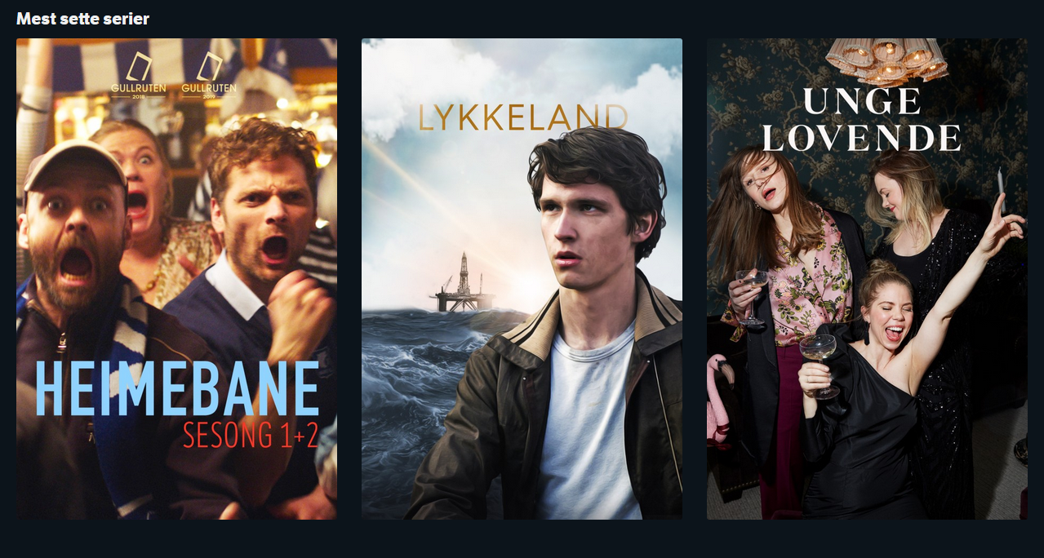
DESKING
Notes:
This is the desking context. This is part of the front page.

Slide 210
DESKING
{ "embedded": { "series": [{ "_links": { "self": { "href": "/series/heimebane" }, "image": { "href": "https://gfx.nrk.no/GKrIe1" } }, "usageRights": { "isGeoBlocked": false }
}, ...] }
}
EMBEDDED SERIES RESOURCE
Notes:
Here we have some suggestions for content that you might want to see. We have an embedded resource for the series Heimebane.

Slide 211
DESKING
{ "embedded": { "series": [{ "_links": { "self": { "href": "/series/heimebane" }, "image": { "href": "https://gfx.nrk.no/GKrIe1" } }, "usageRights": { "isGeoBlocked": false }
}, ...] }
}
EMBEDDED SERIES RESOURCE
GO TO CATALOG CONTEXT
Notes:
Here we have some suggestions for content that you might want to see. We have an embedded resource for the series Heimebane.

Slide 212
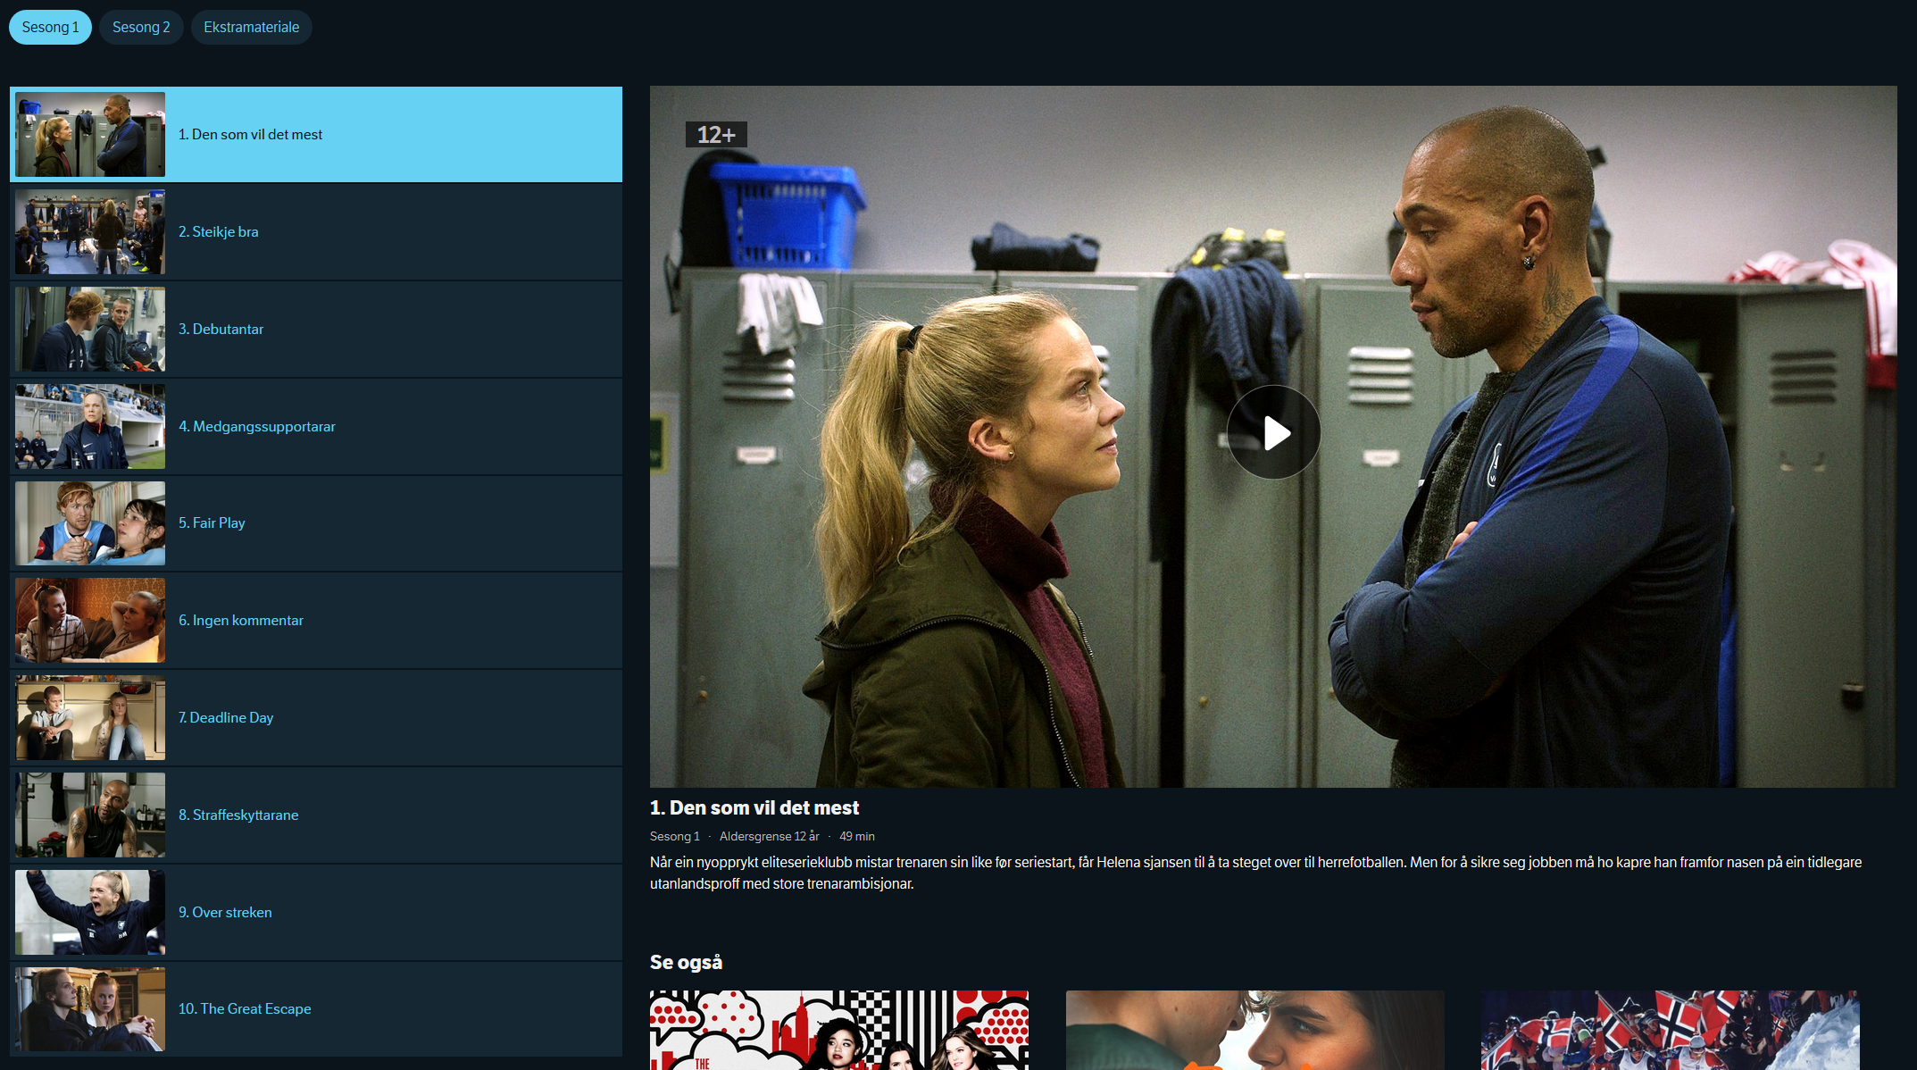
CATALOG
Notes:
If we do that we come to the catalog context

Slide 213
CATALOG
{ "_embedded": {
"episode": [{
"_links": {
"self": {
"href": "/programs/MDRI20000115"
},
"playback": {
"href": "/play/MDRI20000115"
},
"mediaelement": {
"href": "/mediaelement/MDRI20000115"
}, "share": {
"href": "https://tv.nrk.no/se? v=MDRI20000115{&autoplay,t}",
"templated": true
} },
"title": "1. Den som vil det mest", "productionYear": 2018, "rating": "12+", ... }] } }
EMBEDDED EPISODE RESOURCE
Notes:
Here we have a bunch of embedded episode resources. As you can see, each episode in turn has several links.

Slide 214
CATALOG
{ "_embedded": {
"episode": [{
"_links": {
"self": {
"href": "/programs/MDRI20000115"
},
"playback": {
"href": "/play/MDRI20000115"
},
"mediaelement": {
"href": "/mediaelement/MDRI20000115"
}, "share": {
"href": "https://tv.nrk.no/se? v=MDRI20000115{&autoplay,t}",
"templated": true
} },
"title": "1. Den som vil det mest", "productionYear": 2018, "rating": "12+", ... }] } }
GO TO PLAYBACK CONTEXT
Notes:
We can choose to go to the playback context and start watching the episode.

Slide 215
CATALOG
{ "_embedded": {
"episode": [{
"_links": {
"self": {
"href": "/programs/MDRI20000115"
},
"playback": {
"href": "/play/MDRI20000115"
},
"mediaelement": {
"href": "/mediaelement/MDRI20000115"
}, "share": {
"href": "https://tv.nrk.no/se? v=MDRI20000115{&autoplay,t}",
"templated": true
} },
"title": "1. Den som vil det mest", "productionYear": 2018, "rating": "12+", ... }] } }
LEGACY PLAYBACK OPTION
Notes:
Or we can use the legacy playback option, which is one of those older narratives that I talked about, that’s being phased out but is still in use.

Slide 216
CATALOG
{ "_embedded": {
"episode": [{
"_links": {
"self": {
"href": "/programs/MDRI20000115"
},
"playback": {
"href": "/play/MDRI20000115"
},
"mediaelement": {
"href": "/mediaelement/MDRI20000115"
}, "share": {
"href": "https://tv.nrk.no/se? v=MDRI20000115{&autoplay,t}",
"templated": true
} },
"title": "1. Den som vil det mest", "productionYear": 2018, "rating": "12+", ... }] } }
SHARE LINK TO EPISODE
Notes:
Or the client may offer a share link to the end user, to share with their friends.

Slide 217
CATALOG
{ "_embedded": {
"episode": [{
"_links": {
"self": {
"href": "/programs/MDRI20000115"
},
"playback": {
"href": "/play/MDRI20000115"
},
"mediaelement": {
"href": "/mediaelement/MDRI20000115"
}, "share": {
"href": "https://tv.nrk.no/se? v=MDRI20000115{&autoplay,t}",
"templated": true
} },
"title": "1. Den som vil det mest", "productionYear": 2018, "rating": "12+", ... }] } }
GO TO PLAYBACK CONTEXT
Notes:
For now we’ll choose the playback context.

Slide 218
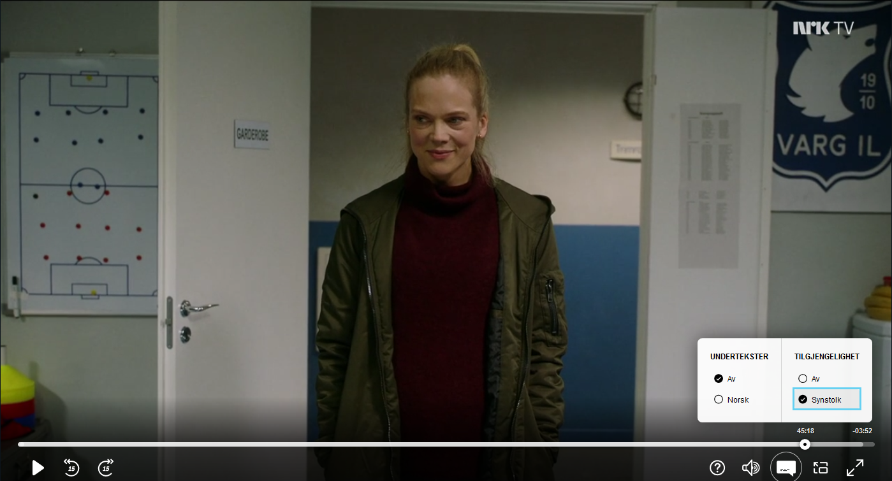
PLAYBACK
GO TO PLAYBACK CONTEXT
Notes:
And here we are in the playback context. Here you can see again that we have the choice between the default version of the manifest and the accessibility version with the commentary.

Slide 219
PLAYBACK
{ "_links": {
"self": {
"href": "/play/MDRI20000115"
},
"manifest": [{ "name": "default",
"href": "/manifest/MDRI20000115"
}, { "name": "synstolk",
"href": "/manifest/MDRI20000115SYNS"
}],
"next": {
"href": "/play/MDRI20000215" }, "series": {
"href": "/series/heimebane" }, "progress": {
"href": "/progress/{user}/MDRI20000215", "templated": true } }, "duration": "PT49M10.92S", ... }
EPISODE PLAYBACK RESOURCE
GO TO PLAYBACK CONTEXT
Notes:
This box is powered by the manifest links. So if we have something more than the default manifest, we’re going to offer those as options here.

Slide 220
PLAYBACK
{ "_links": {
"self": {
"href": "/play/MDRI20000115"
},
"manifest": [{ "name": "default",
"href": "/manifest/MDRI20000115"
}, { "name": "synstolk",
"href": "/manifest/MDRI20000115SYNS"
}],
"next": {
"href": "/play/MDRI20000215" }, "series": {
"href": "/series/heimebane" }, "progress": {
"href": "/progress/{user}/MDRI20000215", "templated": true } }, "duration": "PT49M10.92S", ... }
ACCESSIBILITY OPTION
GO TO PLAYBACK CONTEXT
Notes:
So here we have an accessibility option known as synstolk, which is a version of the episode that contains a running commentary of the visuals.

Slide 221
PLAYBACK
{ "_links": {
"self": {
"href": "/play/MDRI20000115"
},
"manifest": [{ "name": "default",
"href": "/manifest/MDRI20000115"
}, { "name": "synstolk",
"href": "/manifest/MDRI20000115SYNS"
}],
"next": {
"href": "/play/MDRI20000215" }, "series": {
"href": "/series/heimebane" }, "progress": {
"href": "/progress/{user}/MDRI20000215", "templated": true } }, "duration": "PT49M10.92S", ... }
PLAY NEXT EPISODE
GO TO PLAYBACK CONTEXT
Notes:
You also have links to jump to the next episode.

Slide 222
PLAYBACK
{ "_links": {
"self": {
"href": "/play/MDRI20000115"
},
"manifest": [{ "name": "default",
"href": "/manifest/MDRI20000115"
}, { "name": "synstolk",
"href": "/manifest/MDRI20000115SYNS"
}],
"next": {
"href": "/play/MDRI20000215" }, "series": {
"href": "/series/heimebane" }, "progress": {
"href": "/progress/{user}/MDRI20000215", "templated": true } }, "duration": "PT49M10.92S", ... }
BACK TO CATALOG CONTEXT
GO TO PLAYBACK CONTEXT
Notes:
You can go back to the catalog context.

Slide 223
PLAYBACK
{ "_links": {
"self": {
"href": "/play/MDRI20000115"
},
"manifest": [{ "name": "default",
"href": "/manifest/MDRI20000115"
}, { "name": "synstolk",
"href": "/manifest/MDRI20000115SYNS"
}],
"next": {
"href": "/play/MDRI20000215" }, "series": {
"href": "/series/heimebane" }, "progress": {
"href": "/progress/{user}/MDRI20000215", "templated": true } }, "duration": "PT49M10.92S", ... }
GO TO PLAYBACK CONTEXT
REPORT VIEWING PROGRESS
Notes:
And while you’re viewing the show, the client can use this progress link to report how far you’ve watched.

Slide 224
2021
Notes:
That was 5 years of evolution put together to produce a story that can be told in a relatively short amount of time. I’ve glossed over a lot of details, obviously.

Slide 225
THE MONOLITH IS SHRINKING
Notes:
The monolith keeps shrinking. It’s not gone by any means, but it’s shrinking.

Slide 226
NO RELEASE MANAGER
Notes:
We don’t have a release manager anymore. He’s off doing great work in other places.

Slide 227
INDEPENDENT DEPLOYS
Notes:
We have independent deploys. Individual teams deploy at will. We don’t hesitate and ask each other for permission anymore.

Slide 228
PLAIN OLD HTTP CACHING
Notes:
Instead of cunning caching schemes we use very simple plain old HTTP caching.

Slide 229
ALL NEW RESOURCES USE LINKS
Notes:
All new resources use links.

Slide 230
MANY OLD RESOURCES HAVE LINKS
Notes:
Many old resources have been retrofitted with links.

Slide 231
PHASED IN NEW SERVICES
Notes:
We’ve phased in several new services.

Slide 232
PLAYBACK
Notes:
We have a new solution for playback, which is this entire playback context, with a lot of complexity.

Slide 233
TV SHOW PAGES
Notes:
We have these new TV show pages that I talked about in the example, that was based on a true story as they say.

Slide 234
PERSONALIZATION
Notes:
And we have introduced a new solution for personalization built on the Orleans actor system, which is like a pretty cool little subsystem inside our larger system.

Slide 236
SUMMARY
Notes:
To summarize.

Slide 237
DDD + HYPERMEDIA
Notes:
I hope to have convinced you that domain-driven design and hypermedia is a good match, and that they can be used to tackle the problem of modularizing monolithic APIs while the system is running, evolving it into a healthier system.

Slide 238
USE BOUNDED CONTEXTS TO CONQUER COMPLEXITY
Notes:
We used bounded contexts to conquer complexity.

Slide 239
USE LINKS TO EVOLVE AND TO FORM NARRATIVES
Notes:
Links are useful both for forming narratives and for evolving APIs.

Slide 240
WE CONTINUE TO EVOLVE
Notes:
And of course we as well continue to evolve.

Slide 241
ARCHITECTURE IS NEVER DONE

